Slide 1

Introduction

Slide 2
Discrete Measurements
Number of people
Shoe size
Money

Slide 3

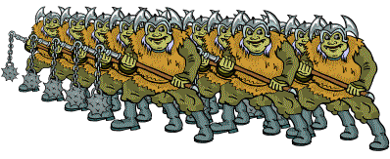
There were an estimated 90 trolls in the field, to the nearest 10.
What was the lowest possible number of trolls ?
What was the highest possible number of trolls ?

Slide 4

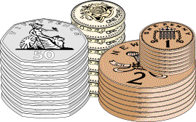
This pile of coins is worth £10 to the nearest £1.
What is the lowest possible value of the coins ?
What is the highest possible value of the coins ?

Slide 5
Continuous Measurements
Height
Weight
Temperature

Slide 6
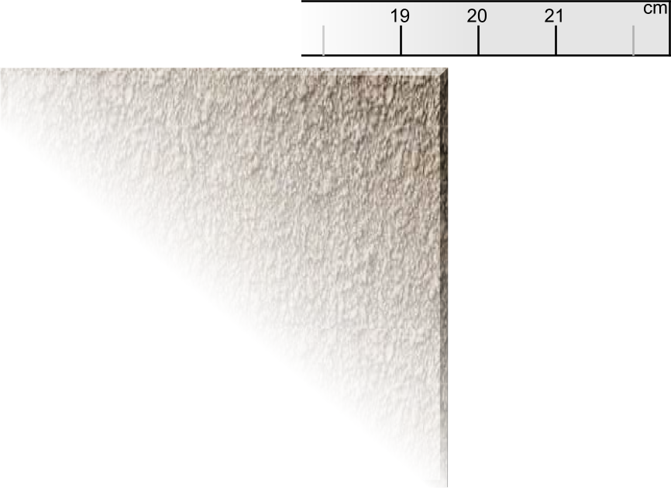
Measuring the length of a floor tile to the nearest cm

Slide 7
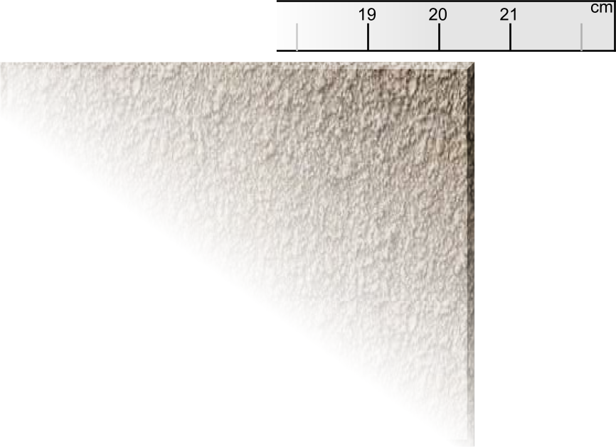
Measuring the length of a floor tile to the nearest cm

Slide 8
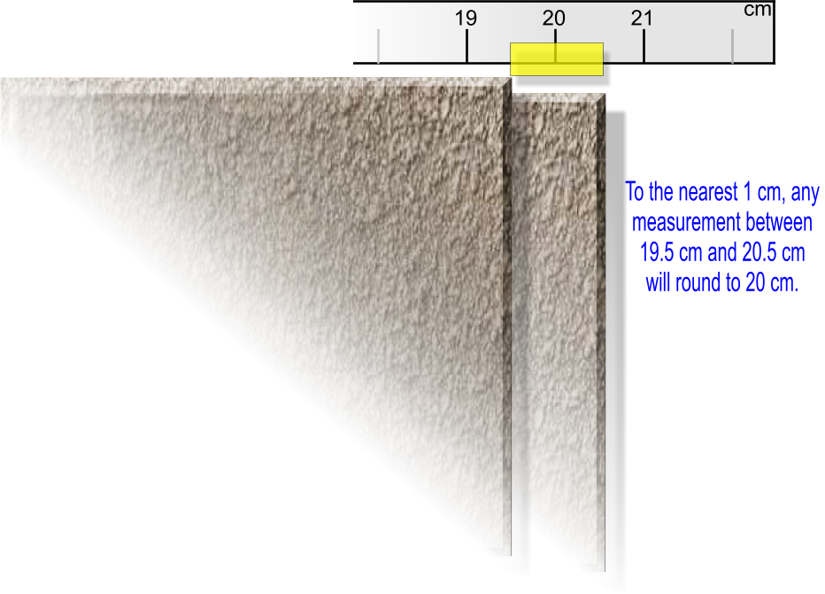
Measuring the length of a floor tile to the nearest cm

Slide 9
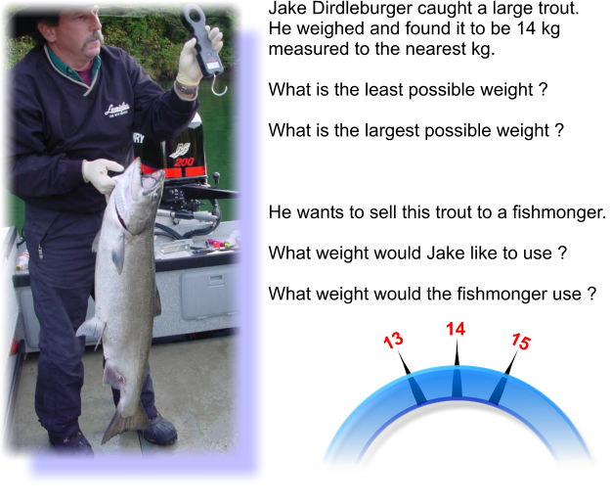

Slide 10
GCSE Questions

Slide 11
Q1
A rectangular piece of cardboard measures 14 cm by 9 cm, each measurement being correct to the nearest cm.
9 cm
Write down the least possible values of the length and the width of the rectangle. [1]
Write down the greatest possible values of the length and the width of the rectangle. [1]
14 cm
a) Least value of the length =
Least value of the width =
14 – 0.5 = 13.5 cm
9 – 0.5 = 8.5 cm
b) Greatest value of the length =
Greatest value of the width =
14 + 0.5 = 14.5 cm
9 + 0.5 = 9.5 cm

Slide 12
Q1
Write down the least and greatest possible values of the perimeter of
the rectangle. [2]
Write down the least and greatest possible values of the area of the rectangle. [2]
Least 8.5 cm
Greatest 9.5 cm
Least 13.5 cm
Greatest 14.5 cm
c) Least perimeter =
Greatest perimeter =
8.5 + 8.5 + 13.5 + 13.5 = 44 cm
9.5 + 9.5 + 14.5 + 14.5 = 48 cm
d) Least area =
Greatest area =
8.5 x 13.5 = 114.75 cm²
9.5 x 14.5 = 137.75 cm²

Slide 13
Q1
Four of these pieces of cardboard are placed, in a row, with their shorter sides joined. Calculate the least and greatest possible values of the length of the four pieces of cardboard. [3]
Least 8.5 cm
Greatest 9.5 cm
Least 13.5 cm
Greatest 14.5 cm
e) Least length =
Greatest length =
4 x 13.5 = 54 cm
4 x 14.5 = 56 cm

Slide 14
Q1
Two pieces of cardboard are placed as shown in the diagram. Calculate the least and greatest possible values of the length of the AB. [3]
Least length 13.5 cm
Greatest length 14.5 cm
A
B
Least width 8.5 cm
Greatest width 9.5 cm
f) Least length of AB =
Greatest length of AB =
13.5 – 9.5 = 4 cm
14.5 – 8.5 = 6 cm

Slide 15
Q2
A rectangular piece of cardboard have lengths of 28 cm and widths of 16 cm, each measurement being correct to the nearest cm.
16 cm
28 cm
Write down the least possible values of the length and the width of the rectangle. [1]
Four of these pieces of cardboard are placed in a row, with their shorter sides joined. Calculate the least and greatest possible values of the length of the four pieces of cardboard[3]
Two pieces of cardboard are placed as shown in the diagram. Calculate the least and greatest possible values of the length AB. [3]
Least length = 27.5 cm, Least width = 15.5 cm
Least = 4 x 27.5 = 110 cm, Greatest = 4 x 28.5 = 114 cm
A
B
Least = 27.5 – 16.5 = 11 cm,
Greatest = 28.5 – 15.5 = 13 cm

Slide 16
Q3
The length of a desk is measured as 180 cm, correct to the nearest cm.
Write down the least and greatest values of the length of the desk. [2]
Three of these desks are laid end to end along their lengths. What is the least value that the total length of the three desks can be ? [1]
The distance between two walls is measured as 3 metres correct to the nearest centimetre.
  Write down, in centimetres, the least and greatest values of the distance between the two walls. [1]
Least length = 179.5 cm, Greatest length = 180.5 cm
Least = 3 x 179.5 = 538.5 cm
Least = 299.5 cm, Greatest = 300.5 cm

Slide 17

Q3
One desk is placed lengthwise between two walls and in contact with the left hand wall, as shown in the diagram.
What is the greatest possible length of the gap between the desk and the right hand wall? [2]
Greatest distance = 300.5 cm
Least length = 179.5 cm
Wall
desk
Wall
Gap
Floor
Greatest gap =300.5 – 179.5 = 121 cm

Slide 18
Q4
A lump pf plasticine has a mass of 500 g, correct to the nearest 10 g. A piece of the plasticine is removed and found to have a mass of 310 g, correct to the nearest 10 g.
Find the greatest possible value of the mass of the remaining lump of plasticine. [2]
Preparation
Least mass of original lump of plasticine = 500 – 5 = 495 g
Greatest mass of original lump of plasticine = 500 + 5 = 505 g
Least mass of removed lump of plasticine = 310 – 5 = 305 g
Greatest mass of removed lump of plasticine = 310 + 5 = 315 g
Greatest remaining mass = 505 – 305 = 200 g

Slide 19
Q5
A rectangle’s measurements are given as 30 cm by 20 cm, correct to the nearest cm.
Find the least possible length of the perimeter of the rectangle. [2]
Preparation
Minimum dimensions are 29.5 cm by 19.5 cm
Least perimeter = 2 x (29.5 + 19.5) = 98 cm

Slide 20
GCSE Questions
The End

