Slide 1
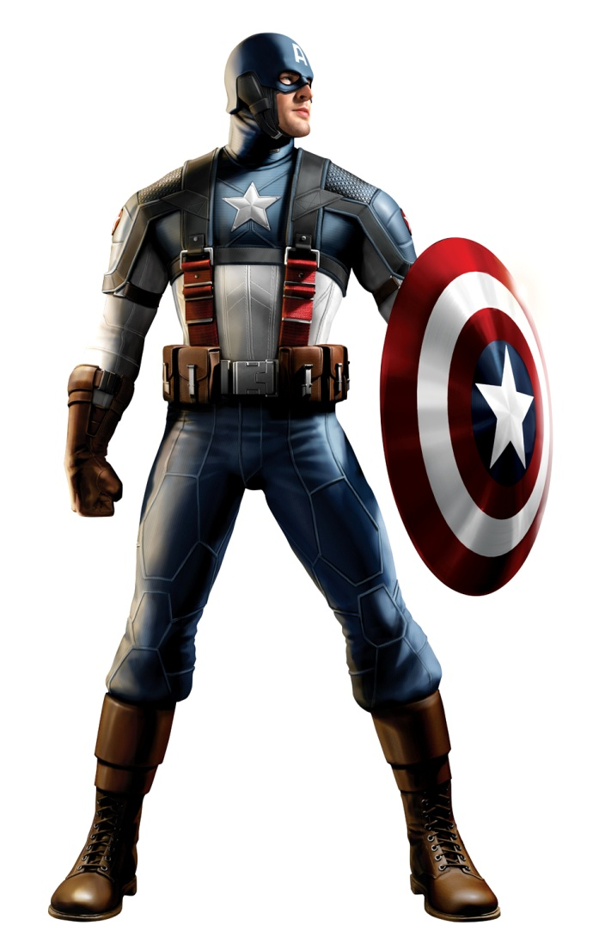
Significant Figures

Slide 2
Rounding to Decimal Places
10 multiple choice questions

Slide 3
Round to 1 dp
0.34
0.4
0.3
A)
B)
0.35
3
C)
D)

Slide 4
Round to 1 dp
0.48
0.49
0.4
A)
B)
0.47
0.5
C)
D)

Slide 5
Round to 1 dp
2.75
2.8
2.74
A)
B)
2.7
3.0
C)
D)

Slide 6
Round to 1 dp
13.374
13.0
14.0
A)
B)
13.3
13.4
C)
D)

Slide 7
Round to 1 dp
26.519
25.0
26.6
A)
B)
26.0
26.5
C)
D)

Slide 8
Round to 2 dp
23.1782
23.20
23.18
A)
B)
23.10
23.17
C)
D)

Slide 9
Round to 2 dp
500.8251
500.80
500.8
A)
B)
500.83
500.84
C)
D)

Slide 10
Round to 3 dp
0.00417
0.00417
0.004
A)
B)
0.00418
0.005
C)
D)

Slide 11
Round to 2 dp
4.999
4.99
4.90
A)
B)
5.00
4.98
C)
D)

Slide 12
Round to 4 dp
0.72995
0.7300
0.7390
A)
B)
0.7210
0.7399
C)
D)

Slide 13
Decimal Places
When we round to decimals, we start counting as soon as we reach the decimal point.
Round 17.46789 to 2 decimal places
1 decimal place
2 decimal places, this will stay a 6 or go to a 7 depending on what the next number is

Slide 14
Significant Figures
When we round to significant figures, we start counting as soon as we reach a number that is not zero
Round 17.46789 to 2 significant figures
1 significant figure
2 significant figures, this will stay a 7 or go to a 8 depending on what the next number is
All the numbers after will become zero
Round 17.46789 to 2 significant figures=
17.00000 or just 17

Slide 15
Round to 1 sf
3
7
5
0
0
8
0
3
0
0
4
7
Look at the next number
It’s more than 4 so we round up!

Slide 16
Round to 3 sf
3
7
4
0
0
3
7
8
0
Look at the next number
It’s less than 5 so we round down!

Slide 17
Round to 2 sf
0
.
0
0
2
8
9
9
Look at the next number
It’s more than 4 so we round up!

Slide 18
Round to 3 sf
0
.
0
0
2
0
8
9
7
Look at the next number
It’s more than 4 so we round up!

Slide 19
Rounding to Significant Figures
Main
When you are rounding to decimal places you start counting after the decimal point, but with significant figures you start counting at the first non zero number
1000 1500 1460
200 160 157
40 37 37.1
6 6.1 6.09
0.006 0.0064 0.00640
4.7
0.058
0.19
540

Slide 20
Rounding to Significant Figures (sig fig or s.f)
10 multiple choice questions

Slide 21
Round-
0.23 to 1 s.f
0.3
2
A)
B)
0.2
3
C)
D)

Slide 22
Round-
0.045 to 1 s.f
0.04
0.1
A)
B)
0.0
0.05
C)
D)

Slide 23
Round-
623 to 1 s.f
600
620
A)
B)
630
700
C)
D)

Slide 24
Round-
5328 to 1 s.f
5300
5000
A)
B)
5330
6000
C)
D)

Slide 25
Round-
0.005136 to 2 s.f
0.01
0.0050
A)
B)
0.00514
0.0051
C)
D)

Slide 26
Round-
426.213 to 2 s.f
426.21
430
A)
B)
400.00
420
C)
D)

Slide 27
Round-
3002.01 to 3 s.f
300
3000
A)
B)
3010
3002.0
C)
D)

Slide 28
Round-
983.4 to 1 s.f
100
900
A)
B)
980
1000
C)
D)

Slide 29
Round-
0.00456 to 2 s.f
0.0045
0.004
A)
B)
0.0046
0.00
C)
D)

Slide 30
Round-
36345.3 to 3 s.f
36300
4000
A)
B)
36000
45300
C)
D)

