Slide 1
GCSE Mathematics
Study Skills Seminar
20th September 2018

Slide 2
Session Objectives
Emphasise the importance of GCSE success in Maths.
Look at the structure of the GCSE Maths course and the marks required to achieve each grade.
Organising your revision.
Learning, Applying & Understanding.
Practising and Equipment
Marking and improving
Key Dates 2018-19

Slide 3
Why is GCSE Maths so important?
Welsh Government key benchmark for 16 year olds –
  Level 2 Threshold including English and Maths.
  Welsh Baccalaureate
Employers – expect young employees to be numerate and literate
Teacher Training & Nursing Colleges now demand Grade B Maths and English

Slide 4
Why is GCSE Maths so important?
Nationally recognised quality standard:
Grade C
Starting from problems or contexts that have been presented to them, candidates refine or extend the mathematics used to generate fuller solutions. They give a reason for their choice
of mathematical presentation, explaining features they have selected. Candidates justify their generalisations, arguments or solutions, showing some insight into the mathematical structure
of the problem. They appreciate the difference between mathematical explanation and experimental evidence.

Slide 5
Why is GCSE Maths so important?
Nationally recognised quality standard:
Grade C
In making estimates candidates use appropriate techniques and multiply and divide mentally.They solve numerical problems involving multiplication and division with numbers of any
size using a calculator efficiently and appropriately. They understand the effects of multiplying and dividing by numbers between 0 and 1. They use ratios in appropriate situations. They understand and use proportional changes. Candidates find and describe in symbols the next term or the nth term of a sequence, where the rule is linear. Candidates calculate one quantity as a percentage of another. They multiply two expressions of the form (x + n); they simplify the corresponding quadratic expressions. They solve simple polynomial equations by trial and improvement and represent inequalities using a number line. They formulate and solve linear equations with whole number coefficients. They manipulate simple algebraic formulae, equations and expressions. Candidates draw and use graphs of quadratic functions.

Slide 6
Why is GCSE Maths so important?
Nationally recognised quality standard:
Grade C
Candidates solve problems using angle and symmetry properties of polygons and properties of intersecting and parallel lines. They understand and apply Pythagoras' theorem when solving problems in two-dimensions. Candidates solve problems involving areas and circumferences of circles. They calculate lengths, areas and volumes in plane shapes and right
prisms. Candidates enlarge shapes by a positive whole number or fractional scale factor. They appreciate the imprecision of measurement and recognise that a measurement given to the
nearest whole number may be inaccurate by up to one half in either direction. They understand and use compound measures such as speed. Candidates use mathematical instruments to carry out accurate constructions of loci

Slide 7
Why is GCSE Maths so important?
Nationally recognised quality standard:
Grade C
Candidates construct and interpret frequency diagrams with grouped data. They specify hypotheses and test them. They determine the modal class and estimate the mean, median and
range of a set of grouped data, selecting the statistic most appropriate to their line of enquiry. They use measures of average and range with associated frequency polygons, as appropriate, to compare distributions and make inferences. Candidates understand relative frequency as an estimate of probability and use this to compare outcomes of experiments.

Slide 8
Maths is heavy on content..

Slide 9
WJEC GCSE Mathematics & Numeracy
Two distinct qualifications with significant overlap in content
Each have two 1 ¾ hour written papers, each containing 80 marks.
Paper 1 is non-calculator.
Paper 2 calculator allowed.
Grade range of GCSE qualification A*-G, but not accessible on one set of papers.
Three tiers of entry – Foundation (Grades G up to D), Intermediate (Grades E to B) & Higher (Grades C up to A*).

Slide 10
Grade Boundaries
Higher (/160) | A* | A | B | C
Maths | 105 | 81 | 57 | 30
Numeracy | 112 | 86 | 60 | 34

Slide 11
Grade Boundaries
Intermediate (/160) | B | C | D | E
Maths | 106 | 80 | 53 | 32
Numeracy | 104 | 80 | 60 | 38
Since the introduction of these courses in 2016 the boundary thresholds have risen from 64 to achieve a C grade in Nov 16 to 80 to achieve a C grade in June 2018

Slide 12
Getting your Revision Organised
Jones the Sums
  www.jonesthesum.co.uk
Revising for Maths

Slide 13
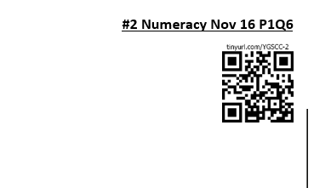
Getting your Revision Organised
This job is easier for you!
  Maths Folder
  Lesson Planner
  Website
  QR Codes

Slide 14
Learning, Applying & Understanding
Most topics in maths can be broken down into these three areas:
  Learning – What do I need to know in order to make questions on this topic accessible?
  Applying – Can I take my learning and apply it to answering straightforward questions on the topic?
  Understanding – If a question disguises the topic, do I have the ability to recognise the topic and adopt an appropriate strategy to answer the question?

Slide 15
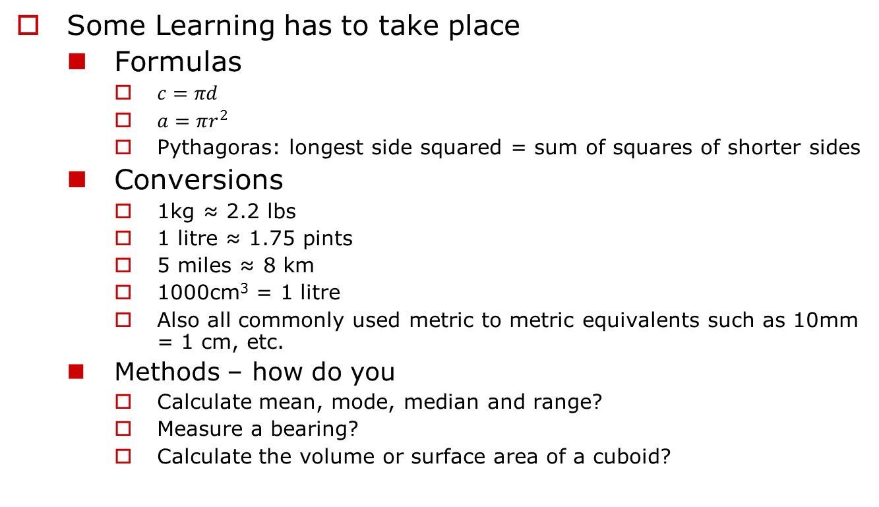
Learning, Applying & Understanding
Some Learning has to take place
  Formulas
    $c=πd$
    $a=πr^{2}$
    Pythagoras: longest side squared = sum of squares of shorter sides
  Conversions
    1kg ≈ 2.2 lbs
    1 litre ≈ 1.75 pints
    5 miles ≈ 8 km
    1000cm³ = 1 litre
    Also all commonly used metric to metric equivalents such as 10mm = 1 cm, etc.
  Methods – how do you
    Calculate mean, mode, median and range?
    Measure a bearing?
    Calculate the volume or surface area of a cuboid?

Slide 16
Learning, Applying & Understanding
Some Learning has to take place
  Geometric Terms – what do we mean by
    Parallel and perpendicular
    Radius, diameter, circumference, tangent, chord
  Identifying shapes and objects – recognize and know the properties of
    Square, rectangle, trapezium, rhombus, quadrilateral
    Triangle, isosceles, equilateral, right angled
    Polygons – pentagon, hexagon, etc
    Cuboid, prism, cylinder, tetrahedron, cone, sphere
  Angle Properties of
    Intersecting lines
    Parallel lines
    Triangles, quadrilaterals and regular polygons
    Circles

Slide 17
Learning

Slide 18
Applying
What if this question had asked for the perimeter of the semi-circle?

Slide 19
Understanding

Slide 20
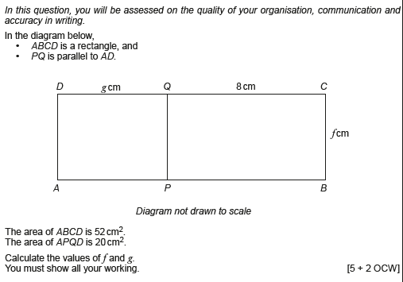
GCSE Mathematics

Slide 21
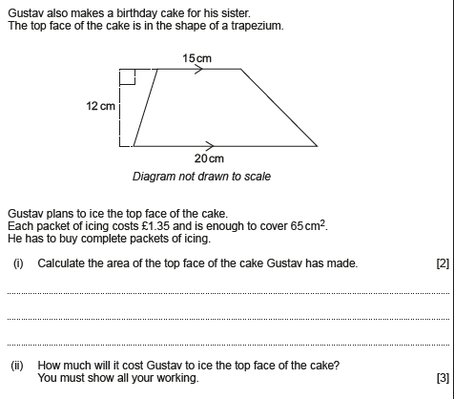
GCSE Numeracy

Slide 22
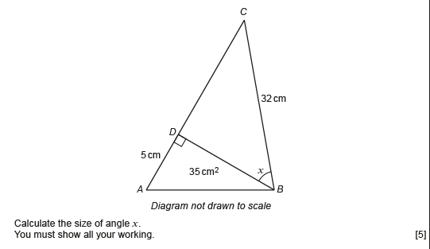
GCSE Mathematics

Slide 23
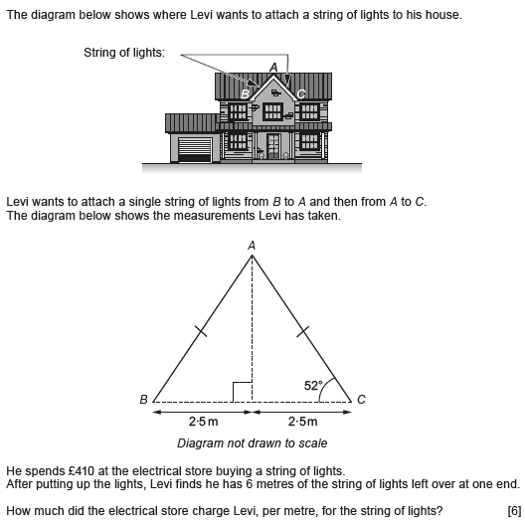
GCSE Numeracy

Slide 24

Practice makes perfect
Whether you are working through topic papers or mixed papers before answering a question always…

Slide 25
Practice makes perfect
Whether you are working through topic papers or mixed papers, before answering a question always…
  Read
  Think
  Pause
  Engage
Before moving on – does your answer look sensible?

Slide 26
You need to know how to use your kit
Scientific calculator
Ruler
Protractor
Compass
Pencil (use to draw all graphs and diagrams on exam paper in case you make a mistake)
Rubber

Slide 27
You need to mark your work
Topic papers and many of the past papers have Jones video solutions - should be straightforward to use.

Slide 28
Learn from your mistakes
Avoid the temptation to keep practising what you’re good at.
Go through the topic work and challenges you’ve done:
  How far into a group of questions can you go before you get stuck/go wrong?
  What’s the problem?
  Can you fix it?
  Is it worth it?

Slide 29
Key Dates:
  14th or 20th November GCSE Numeracy Paper 1 (TRIAL)
  28th Nov or 4th Dec GCSE Numeracy Paper 2 (TRIAL)
  11th February 2019 Year Parents’ Evening
  12th February 2019 GCSE Maths Paper 1(TRIAL)
  5th March 2019 GCSE Maths Paper 2(TRIAL)
  7th May 2019 GCSE Numeracy Paper 1
  9th May 2019 GCSE Numeracy Paper 2
  21st May 2019 GCSE Maths Paper 1
  6th June 2019 GCSE Maths Paper 2

Slide 30

And finally…
Evaluation
  www.tinyurl.com/YGSMathSeminar
jonesn590@hwbmail.net

